Slide 1
New Tasks 01/14/2022 Samaneh

Slide 2
Tasks
For each of the datasets used in slides 6-11 (50% data)and 13-18(at least one-day data), do the following things.
Report the number of ROP;
Run a univariable logistic regression for each of the eight ROP features such as GA, birth weight and so on, and report the P-value for each feature.
Run the following four multivariable logistic regression models
(1) with GA, BW, SGA% and duration as covariates;
(2) with GA, BW, SGA% and %time;
(3) with GA, BW, SGA% and #events; and
(4) with GA, BW, SGA%, duration, %time and #events. For each multivariable logistic model, report p-values for the variables in the model.

Slide 3
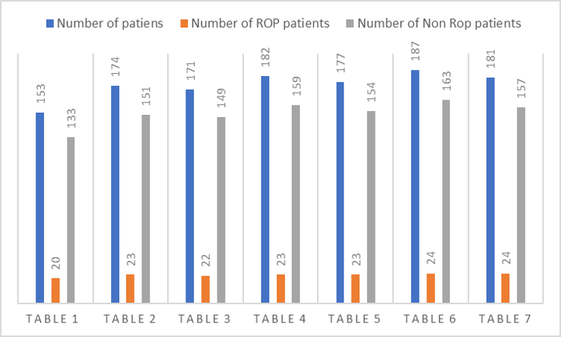
Number of ROP for 50% tables

Slide 4
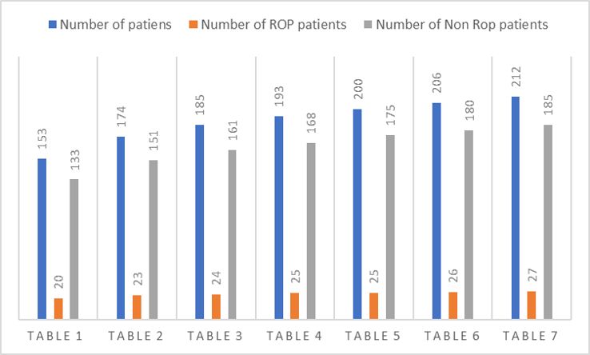
Number of ROP for at least one day data tables

Slide 5
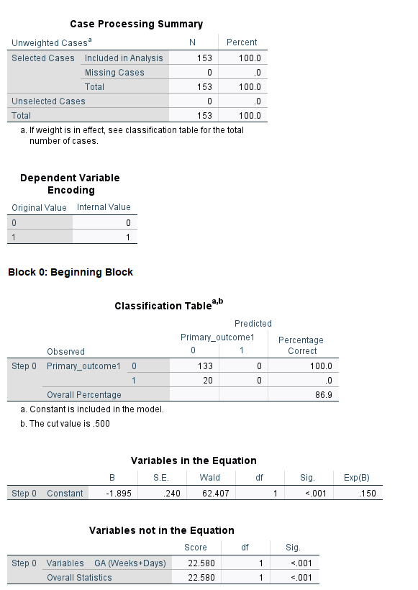
Interpreting binary logistic regression output
The number of cases in each category
Output variable

Slide 6
This part of the output describes a “null model”, which is model with no predictors and just the intercept.
Predicted – In this null model, SPSS has predicted that all cases are 0 on the dependent variable.
Observed – This indicates the number of 0’s and 1’s that are observed in the dependent variable.
Overall Percentage – This gives the percent of cases for which the dependent variables was correctly predicted given the model. In this part of the output, this is the null model. 133/153= 86.9.

Slide 7
Wald – This is the Wald chi-square test that tests the null hypothesis that the constant equals 0.
S.E. – This is the standard error around the coefficient for the constant.
B – This is the coefficient for the constant (also called the “intercept”) in the null model.
Exp(B) – This is the exponentiation of the B coefficient, which is an odds ratio
Sig– p-value
df – This is the degrees of freedom
Score and Sig. – This is a Score test that is used to predict whether or not an independent variable would be significant in the model.

Slide 8
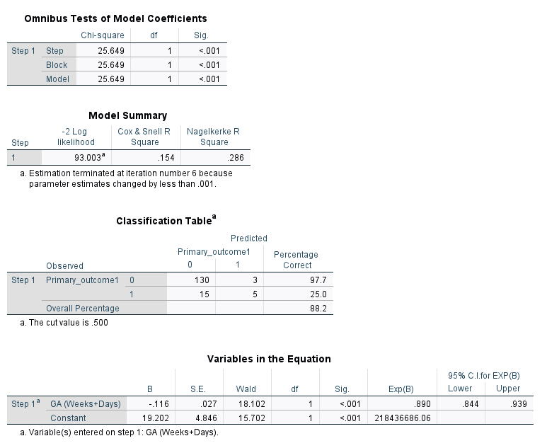
Interpreting binary logistic regression output
Chi-square and Sig. – This is the chi-square statistic and its significance level
df – This is the degrees of freedom

Slide 9
Interpreting binary logistic regression output
Cox & Snell R Square and Nagelkerke R Square – These are pseudo R-squares.
-2 Log likelihood – This is the -2 log likelihood for the final model.
Overall Percentage – This gives the overall percent of cases that are correctly predicted by the mode

Slide 10
Interpreting binary logistic regression output
Wald – This is the Wald chi-square test that tests the null hypothesis that the constant equals 0.
S.E. – This is the standard error around the coefficient for the constant.
B – These are the values for the logistic regression equation for predicting the dependent variable from the independent variable.
Exp(B) – This is the exponentiation of the B coefficient, which is an odds ratio
df – This is the degrees of freedom
Score and Sig. – This is a Score test that is used to predict whether or not an independent variable would be significant in the model.

Slide 11
Table 1, 50% data, Gestational Age(GA)

Slide 12
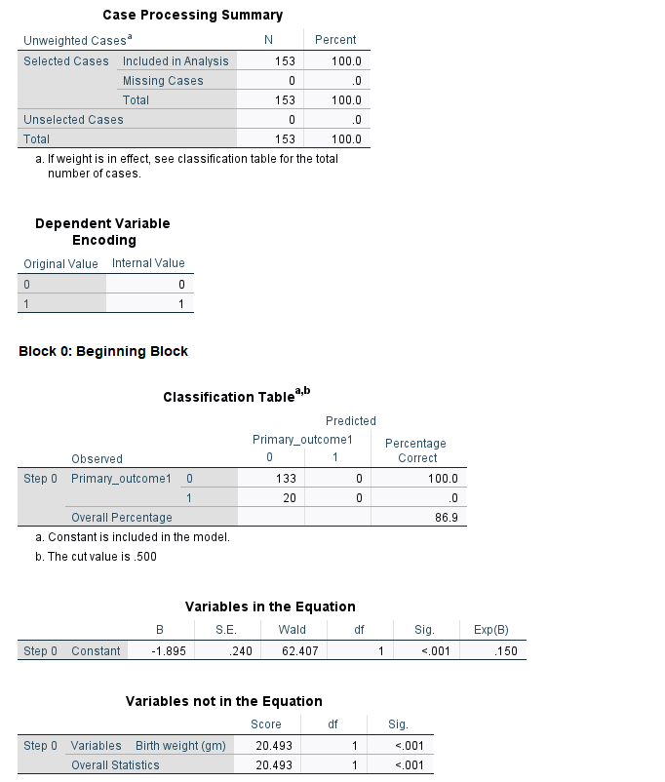
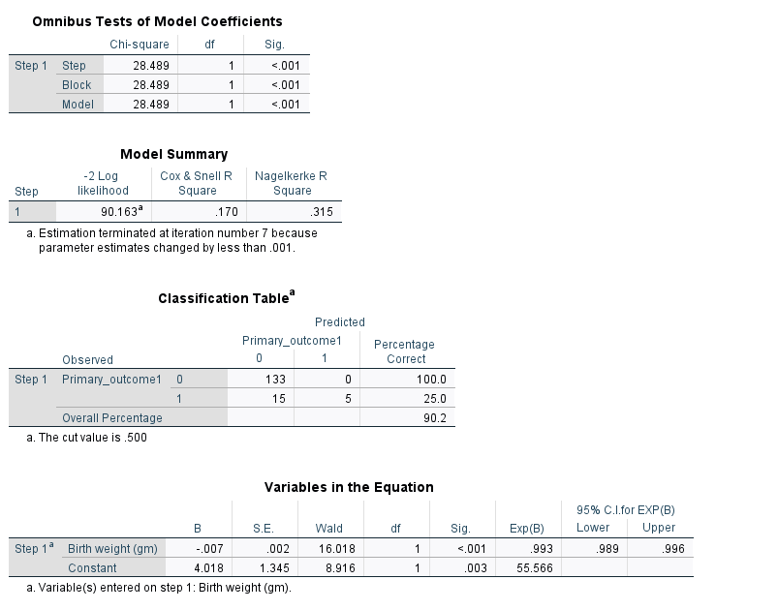
Table 1, 50% data, Birth weight

Slide 13
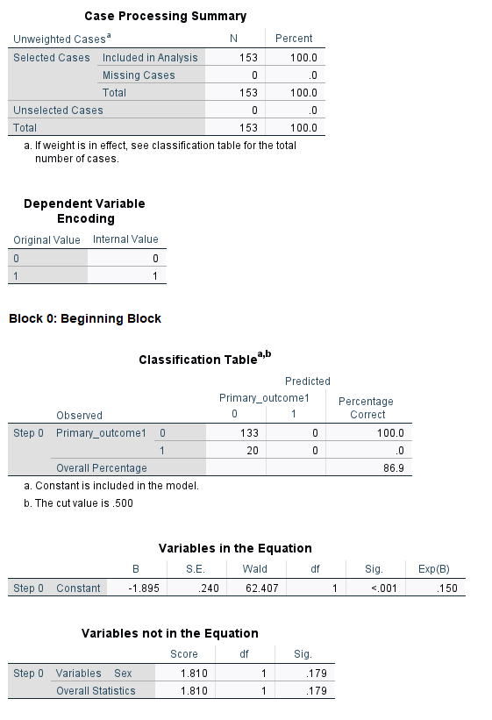
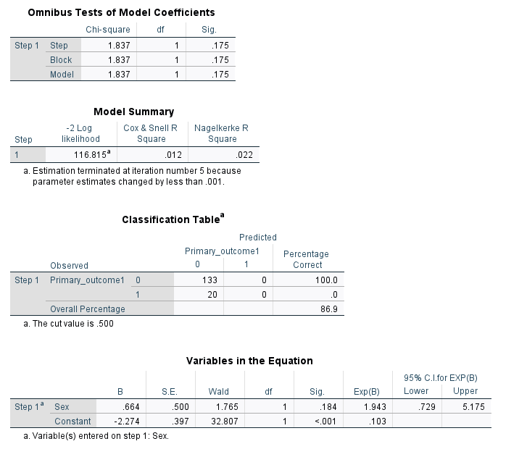
Table 1, 50% data, Sex

Slide 14
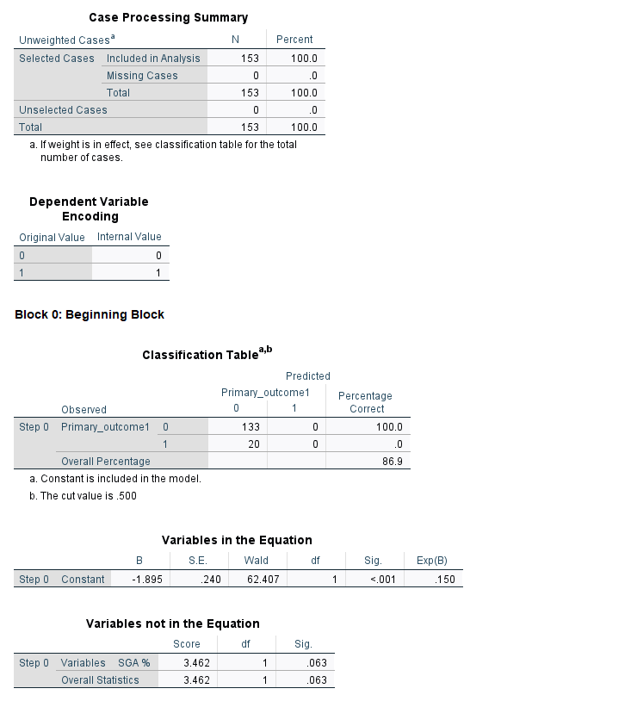
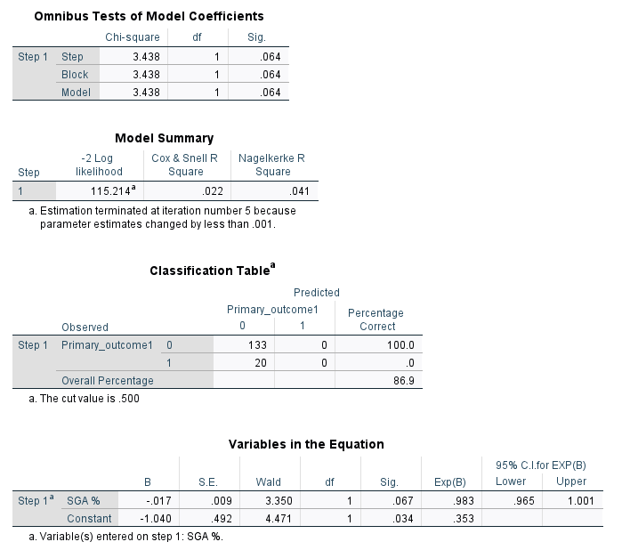
Table 1, 50% data, %SGA

Slide 15
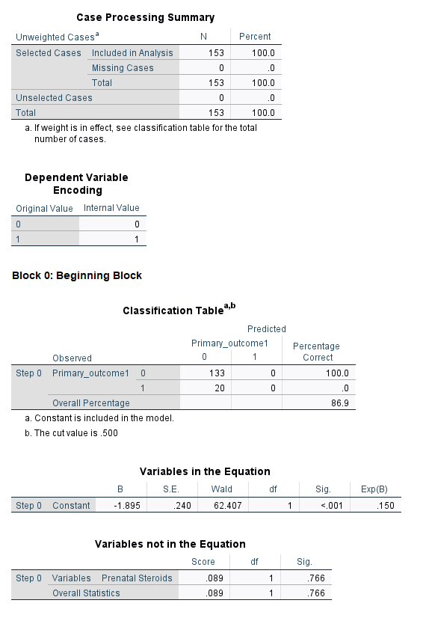
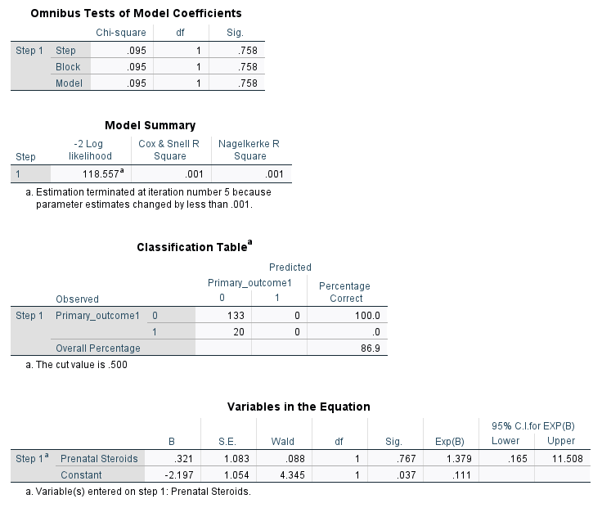
Table 1, 50% data, Prenatal steroids

Slide 16
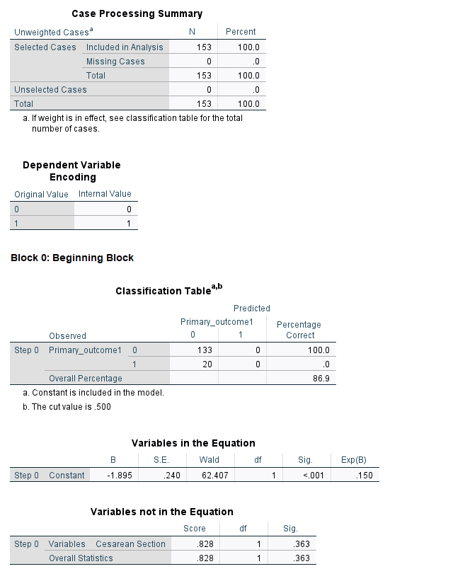
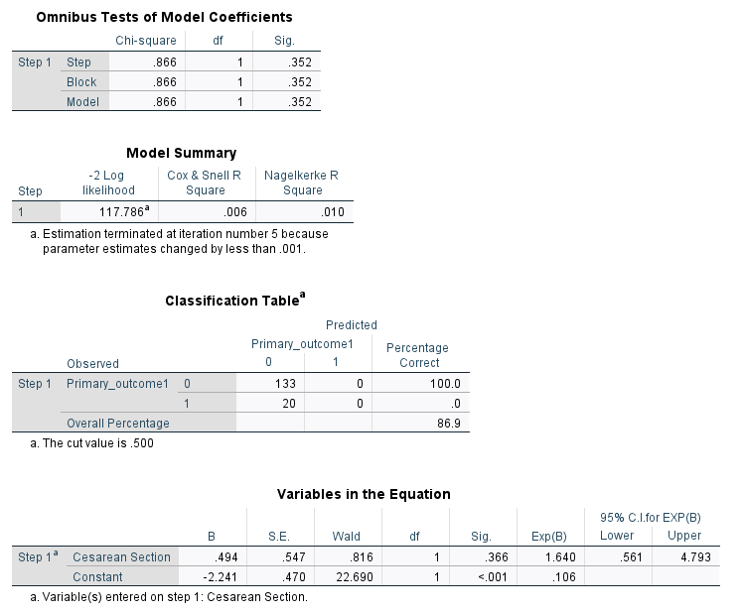
Table 1, 50% data, Cesarean Section

Slide 17
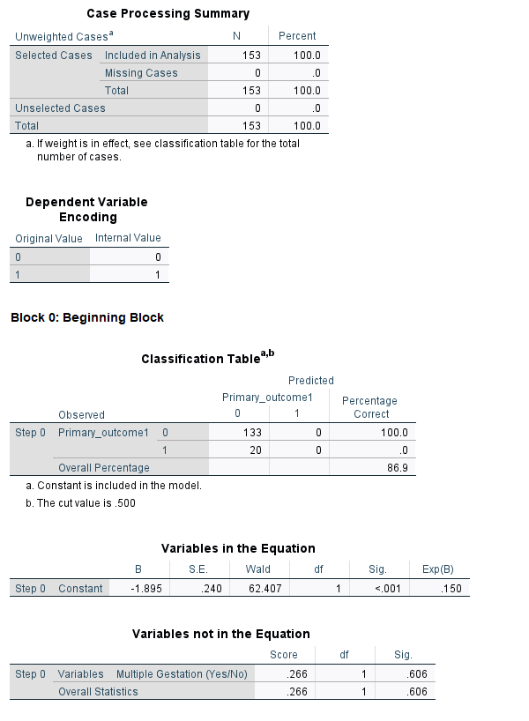
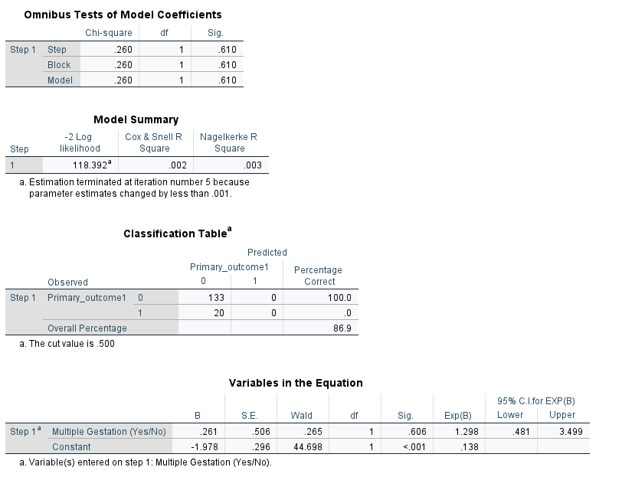
Table 1, 50% data, Multiple Gestations

Slide 18
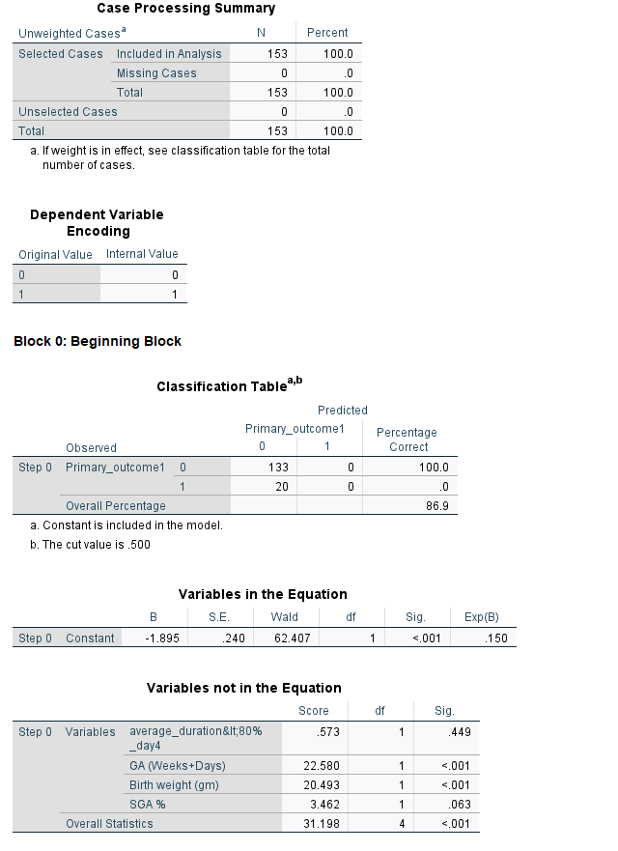
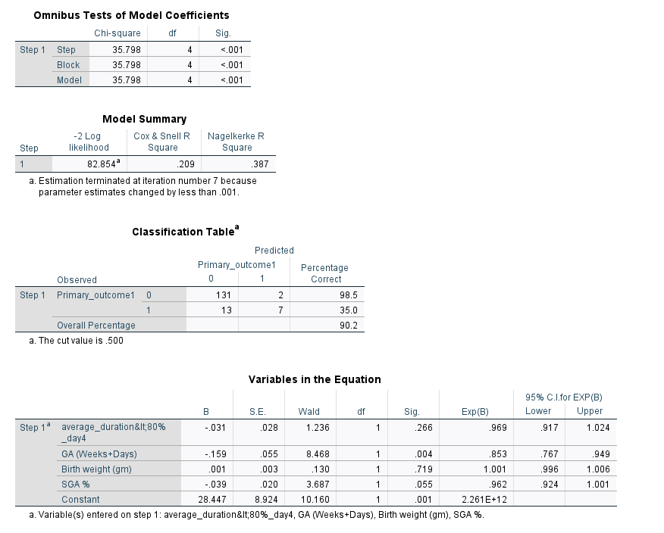
Multivariable logistic regression, GA, BW, %SGA, Duration

Slide 19
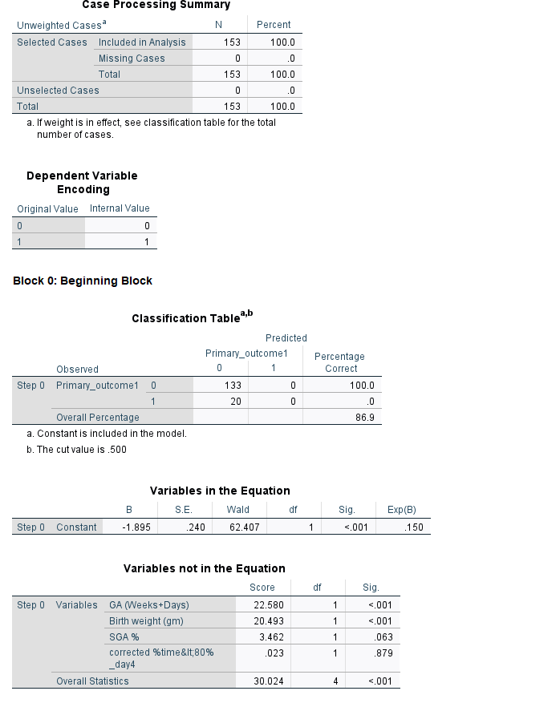
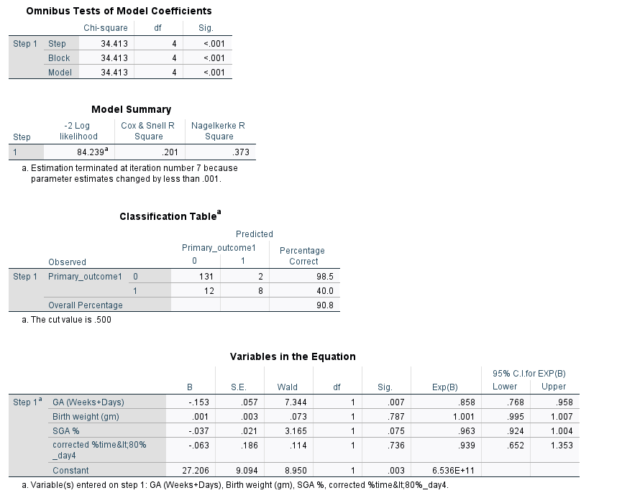
Multivariable logistic regression, GA, BW, %SGA, %time

Slide 20
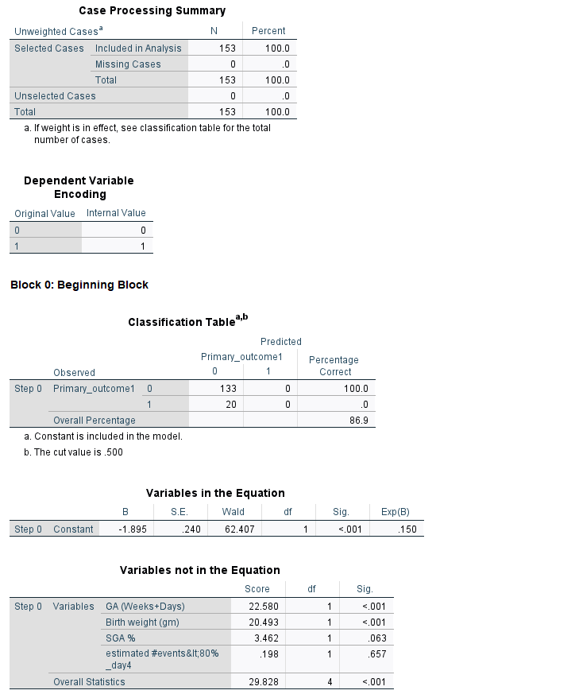
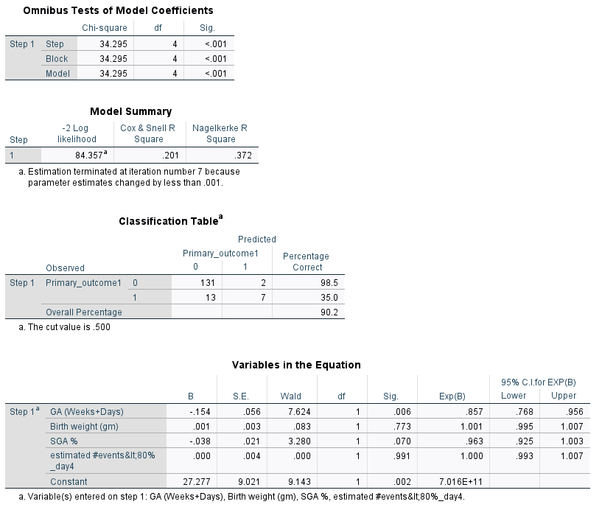
Multivariable logistic regression, GA, BW, %SGA, # event

Slide 21
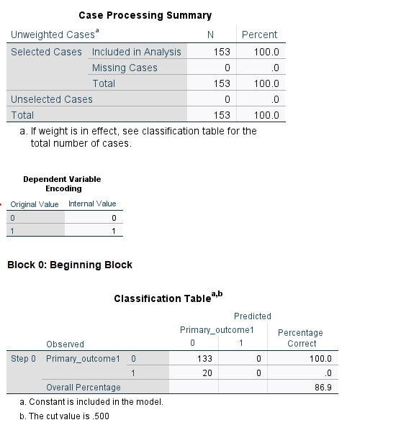
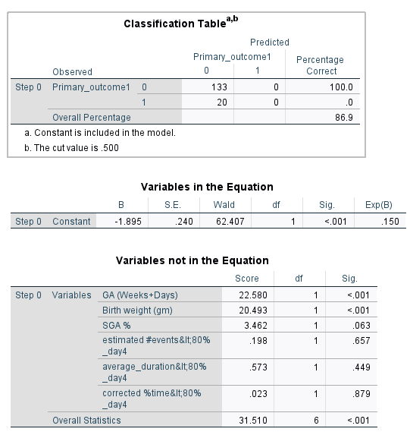
Multivariable logistic regression, GA, BW, %SGA, Duration, %time, #events

Slide 22
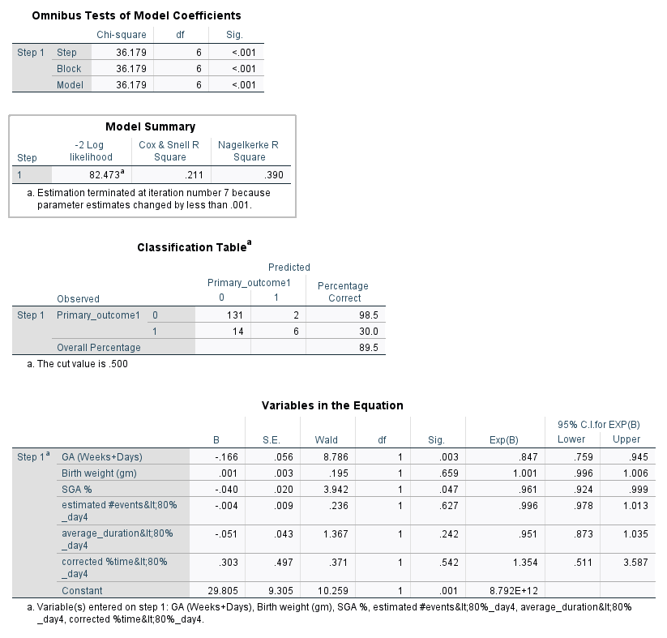
Multivariable logistic regression, GA, BW, %SGA, Duration, %time, #events

Slide 23
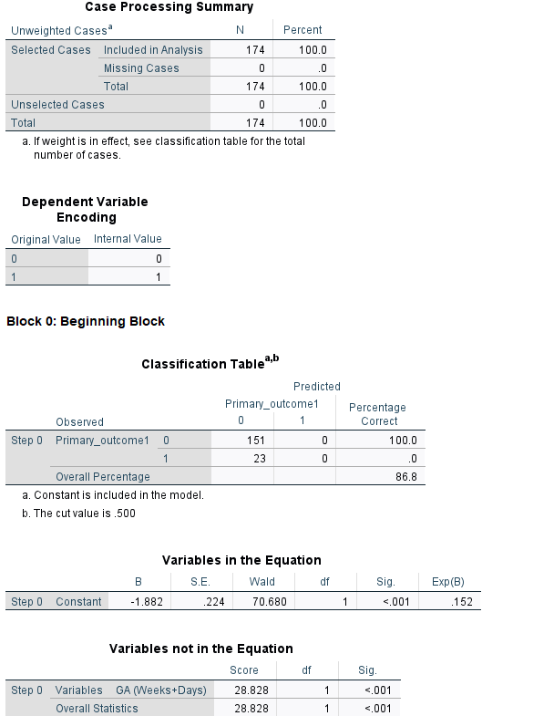
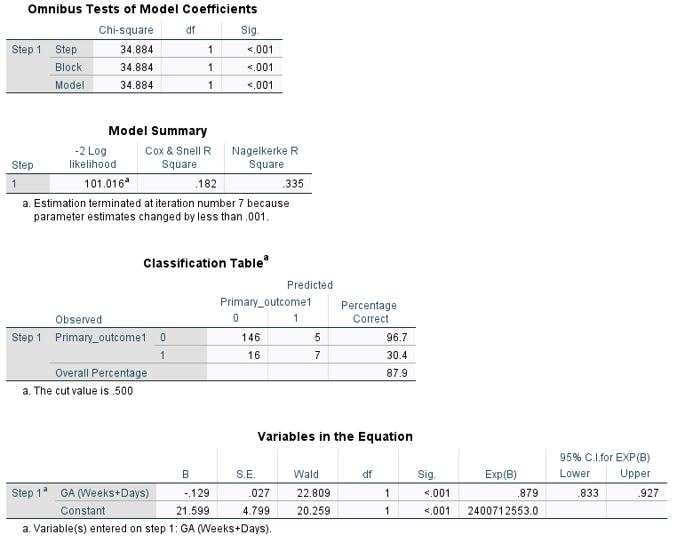
Table 2, 50% data, Gestational Age(GA)

Slide 24
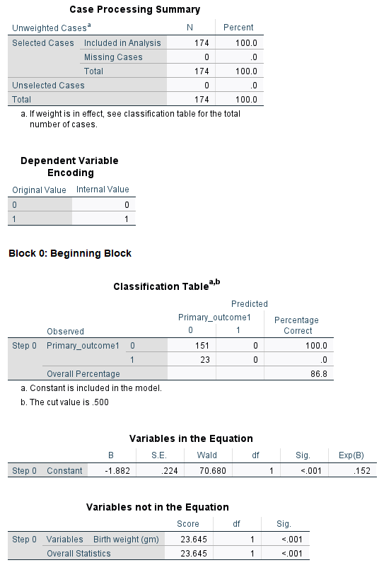
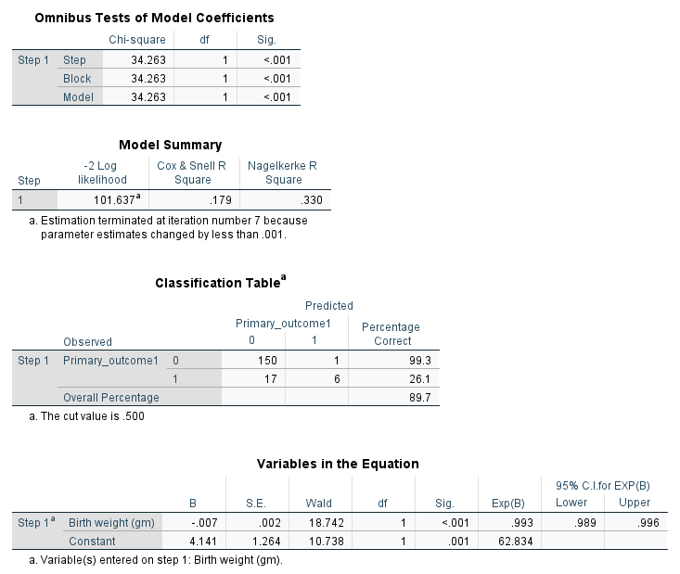
Table 2, 50% data, Birth weight

Slide 25
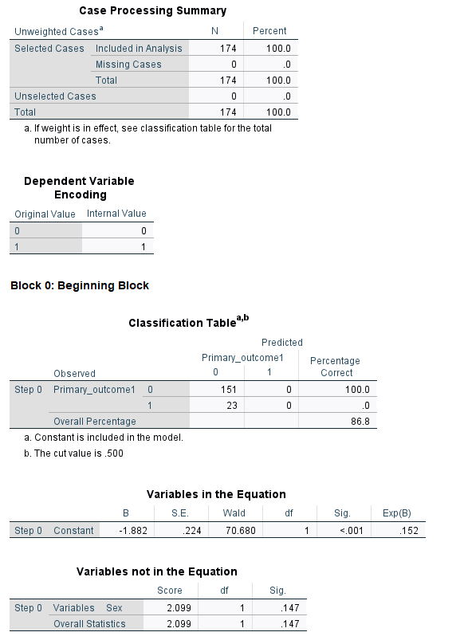
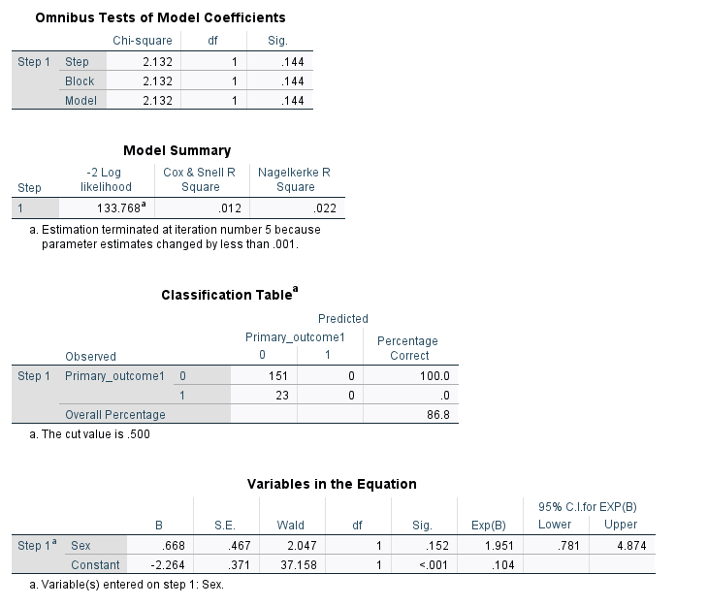
Table 2, 50% data, Sex

Slide 26
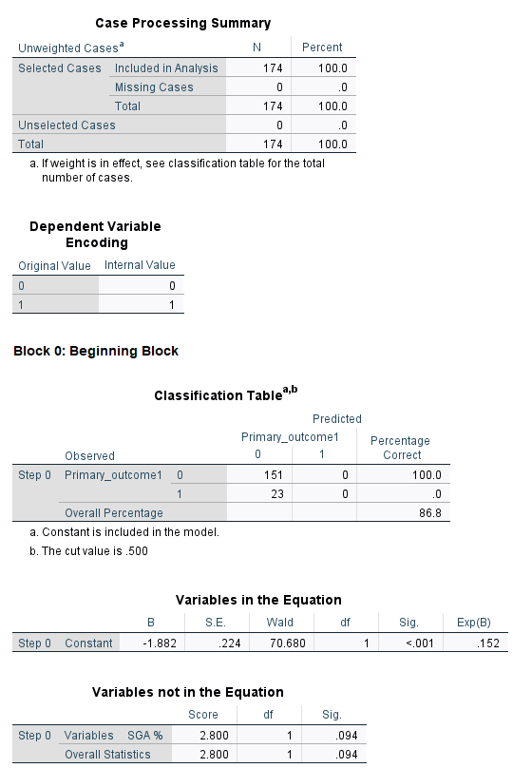
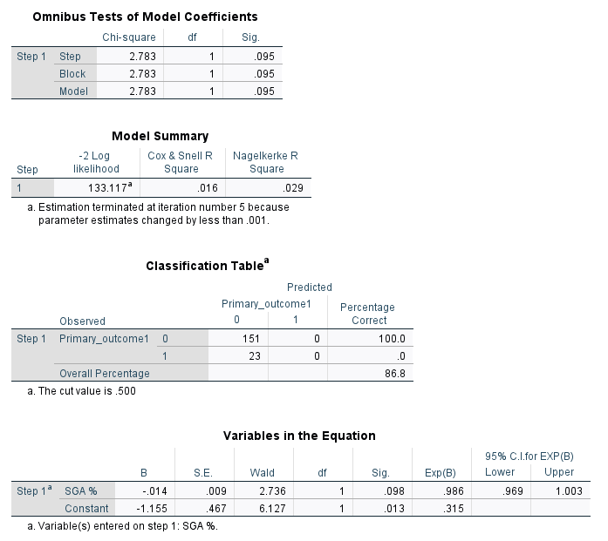
Table 2, 50% data, %SGA

Slide 27
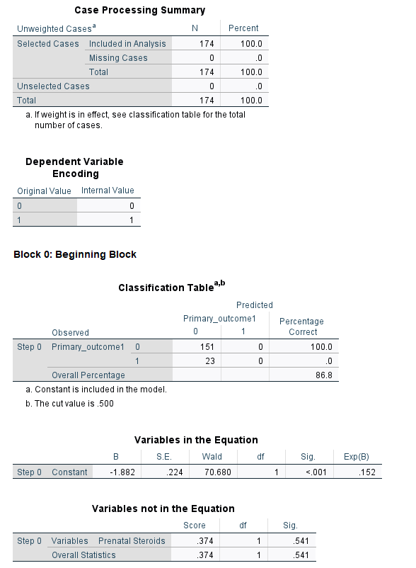
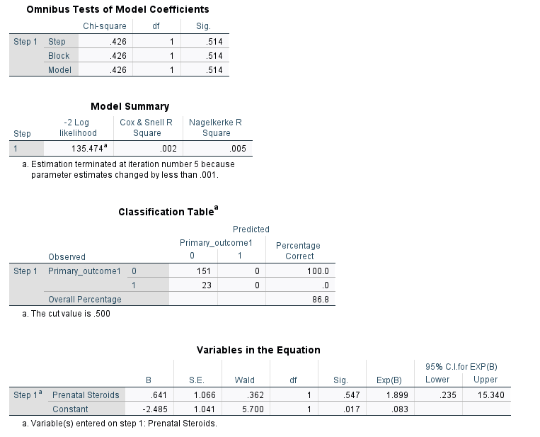
Table 2, 50% data, Prenatal steroids

Slide 28
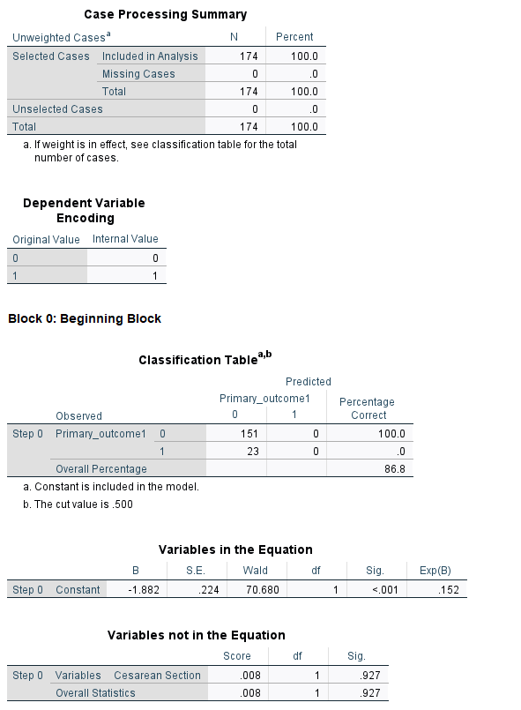
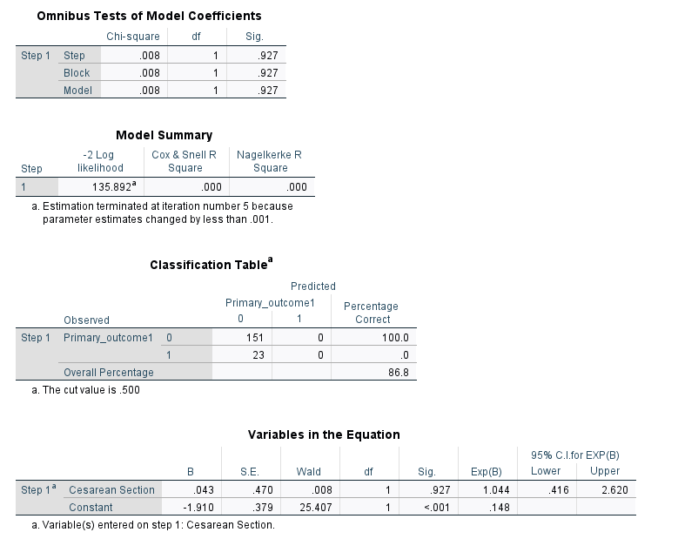
Table 2, 50% data, Cesarean Section

Slide 29
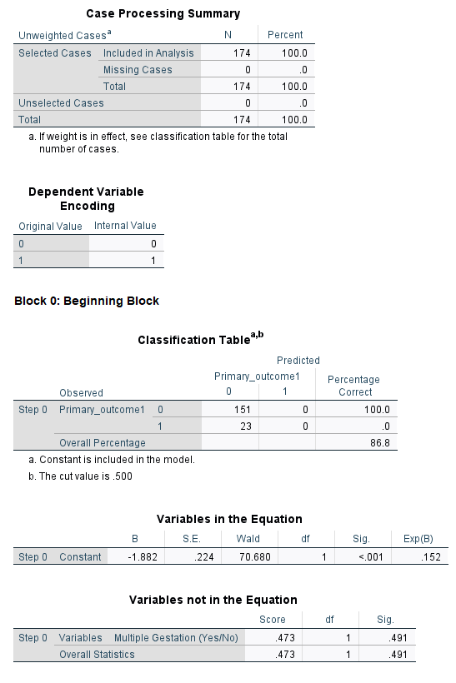
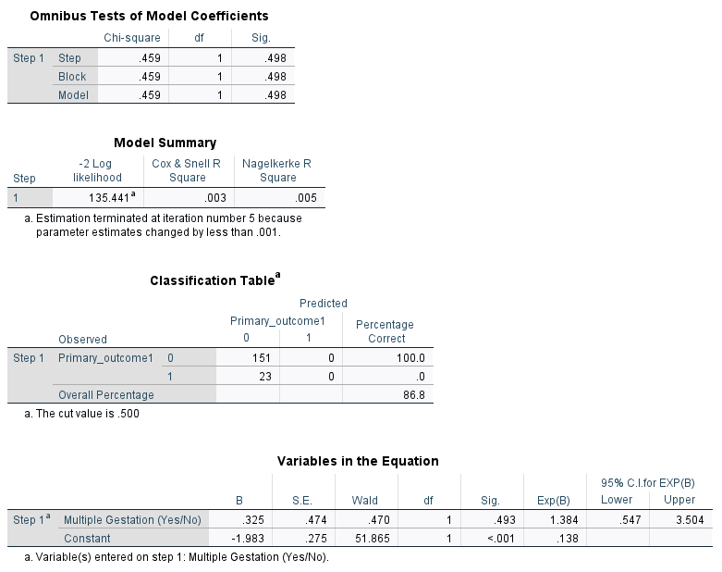
Table 2, 50% data, Multiple Gestations

Slide 30
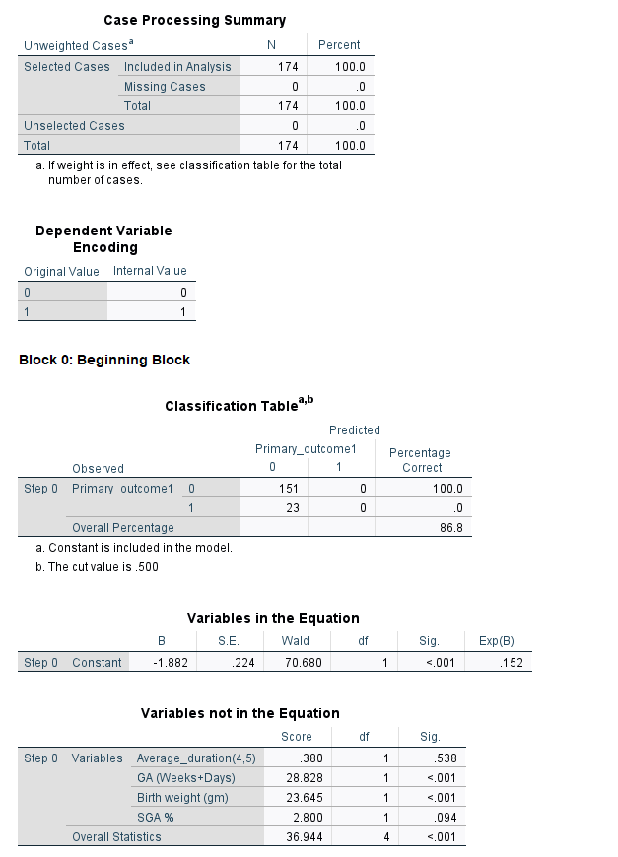
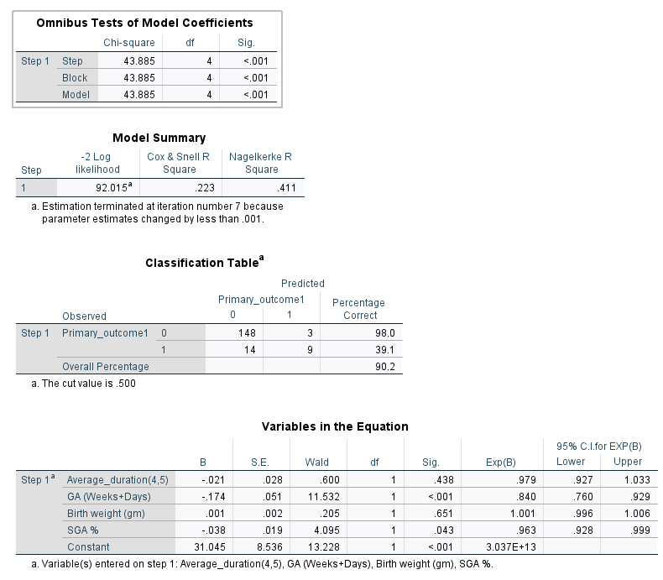
Multivariable logistic regression, GA, BW, %SGA, Duration

Slide 31
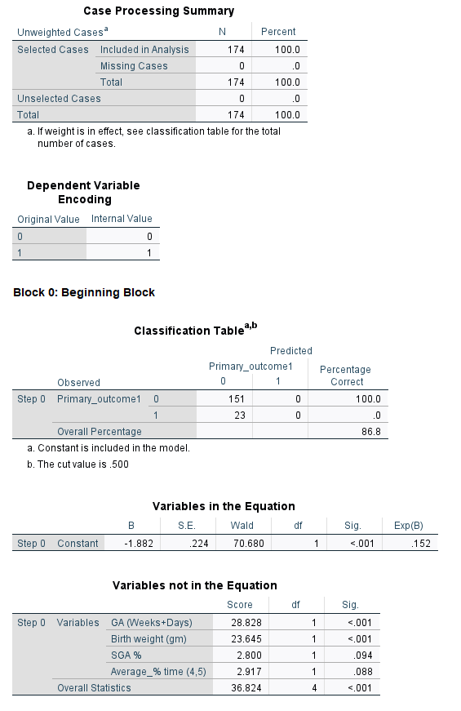
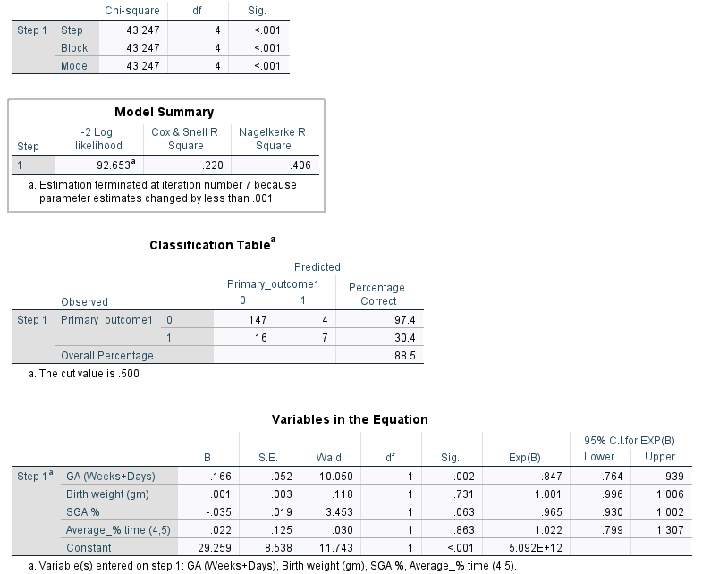
Multivariable logistic regression, GA, BW, %SGA, %time

Slide 32
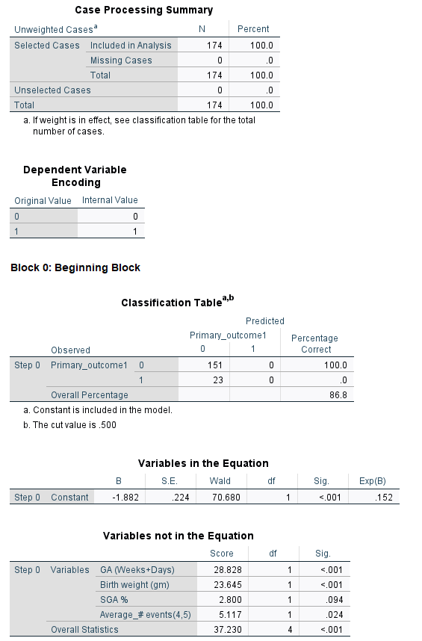
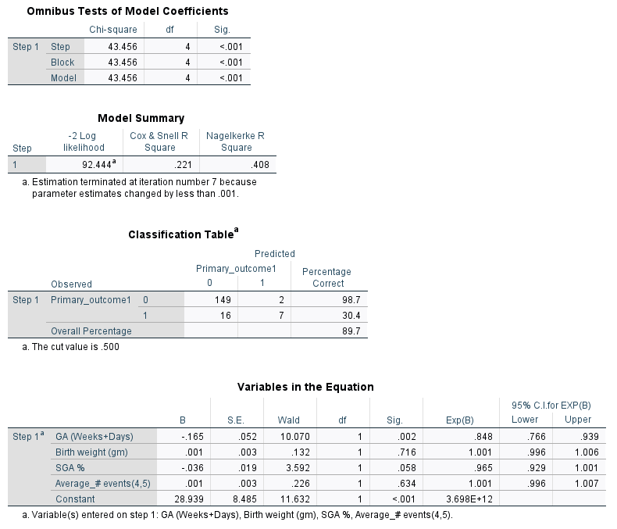
Multivariable logistic regression, GA, BW, %SGA, # event

Slide 33
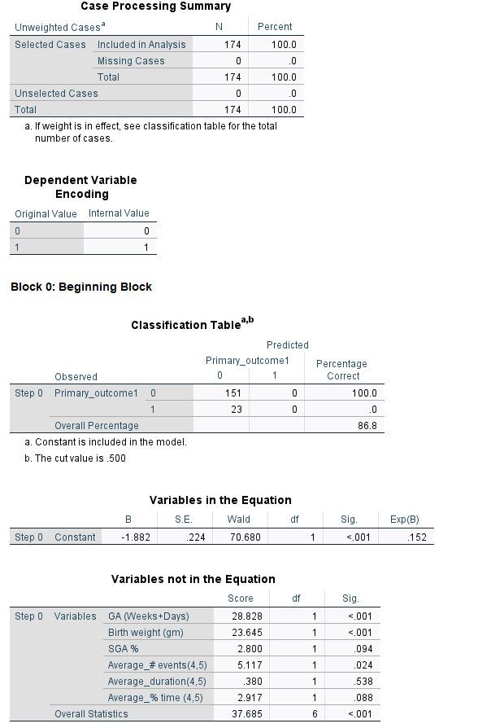
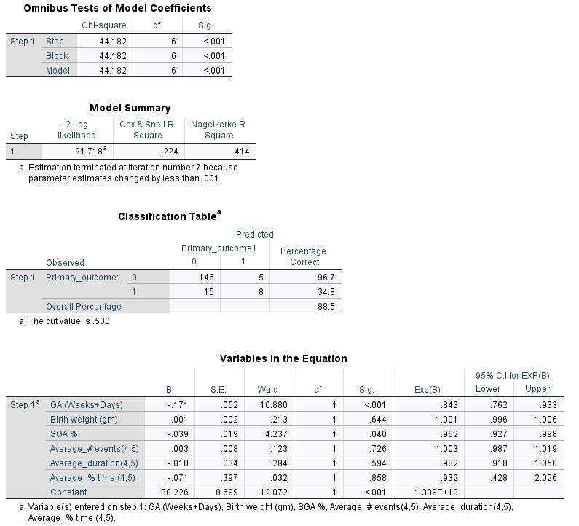
Multivariable logistic regression, GA, BW, %SGA, Duration, %time, #events

Slide 34
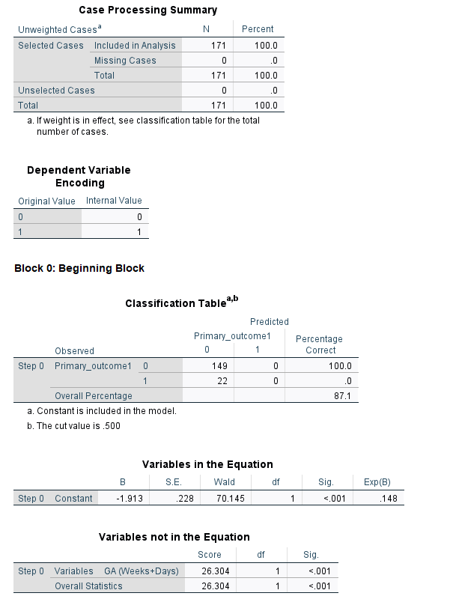
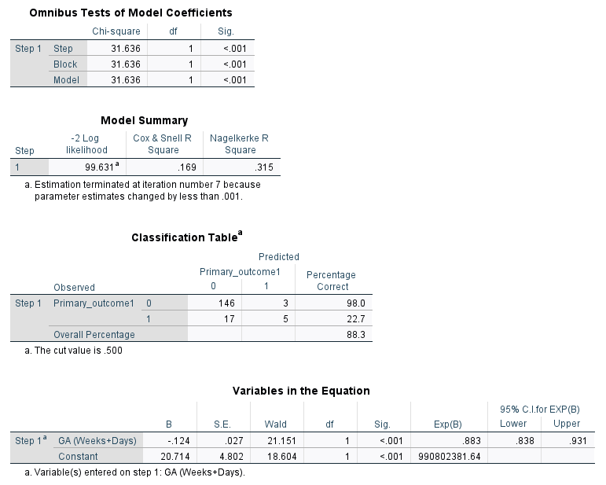
Table 3, 50% data, Gestational Age(GA)

Slide 35
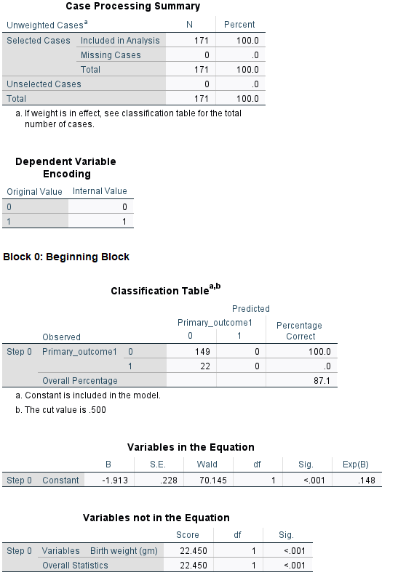

Table 3, 50% data, Birth weight

Slide 36


Table 3, 50% data, Sex

Slide 37


Table 3, 50% data, %SGA

Slide 38


Table 3, 50% data, Prenatal steroids

Slide 39


Table 3, 50% data, Cesarean Section

Slide 40


Table 3, 50% data, Multiple Gestations

Slide 41


Multivariable logistic regression, GA, BW, %SGA, Duration

Slide 42


Multivariable logistic regression, GA, BW, %SGA, %time

Slide 43


Multivariable logistic regression, GA, BW, %SGA, # event

Slide 44


Multivariable logistic regression, GA, BW, %SGA, Duration, %time, #events

Slide 45


Table 4, 50% data, Gestational Age(GA)

Slide 46


Table 4, 50% data, Birth weight(BW)

Slide 47


Table 4, 50% data, Sex

Slide 48


Table 4, 50% data, %SGA

Slide 49


Table 4, 50% data, Prenatal Steroids

Slide 50


Table 4, 50% data, Cesarean Section

Slide 51


Table 4, 50% data, Multiple Gestations

Slide 52


Multivariable logistic regression, GA, BW, %SGA, Duration

Slide 53


Multivariable logistic regression, GA, BW, %SGA, %time

Slide 54


Multivariable logistic regression, GA, BW, %SGA, # event

Slide 55


Multivariable logistic regression, GA, BW, %SGA, Duration, %time, #events

Slide 56


Table 5, 50% data, Gestational Age(GA)

Slide 57


Table 5, 50% data, Birth weight(BW)

Slide 58


Table 5, 50% data, Sex

Slide 59


Table 5, 50% data, %SGA

Slide 60


Table 5, 50% data, Prenatal Steroids

Slide 61


Table 5, 50% data, Cesarean Section

Slide 62


Table 5, 50% data, Multiple Gestations

Slide 63


Multivariable logistic regression, GA, BW, %SGA, Duration

Slide 64


Multivariable logistic regression, GA, BW, %SGA, %time

Slide 65


Multivariable logistic regression, GA, BW, %SGA, # event

Slide 66


Multivariable logistic regression, GA, BW, %SGA, Duration, %time, #events

Slide 67


Table 6, 50% data, Gestational Age(GA)

Slide 68


Table 6, 50% data, Birth weight(BW)

Slide 69


Table 6, 50% data, Sex

Slide 70


Table 6, 50% data, %SGA

Slide 71


Table 6, 50% data, Prenatal Steroids

Slide 72


Table 6, 50% data, Cesarean Section

Slide 73


Table 6, 50% data, Multiple Gestations

Slide 74


Multivariable logistic regression, GA, BW, %SGA, Duration

Slide 75


Multivariable logistic regression, GA, BW, %SGA, %time

Slide 76


Multivariable logistic regression, GA, BW, %SGA, # event

Slide 77


Multivariable logistic regression, GA, BW, %SGA, Duration, %time, #events

Slide 78


Table 7, 50% data, Gestational Age(GA)

Slide 79


Table 7, 50% data, Birth weight(BW)

Slide 80


Table 7, 50% data, Sex

Slide 81


Table 7, 50% data, %SGA

Slide 82


Table 7, 50% data, Prenatal Steroids

Slide 83


Table 7, 50% data, Cesarean Section

Slide 84


Table 7, 50% data, Multiple Gestations

Slide 85


Multivariable logistic regression, GA, BW, %SGA, Duration

Slide 86


Multivariable logistic regression, GA, BW, %SGA, %time

Slide 87


Multivariable logistic regression, GA, BW, %SGA, # event

Slide 88


Multivariable logistic regression, GA, BW, %SGA, Duration, %time, #events

Slide 89



Table 3, at least one day data, Gestational Age

Slide 90



Table 3, at least one day data, Birth Weight

Slide 91



Table 3, at least one day data, Sex

Slide 92



Table 3, at least one day data, %SGA

Slide 93



Table 3, at least one day data, Prenatal Steroids

Slide 94



Table 3, at least one day data, Cesarean Section

Slide 95



Table 3, at least one day data, Multiple Gestations

Slide 96


Multivariable logistic regression, GA, BW, %SGA, Duration

Slide 97


Multivariable logistic regression, GA, BW, %SGA, Duration

Slide 98


Multivariable logistic regression, GA, BW, %SGA, %time

Slide 99


Multivariable logistic regression, GA, BW, %SGA, %time

Slide 100


Multivariable logistic regression, GA, BW, %SGA, # event

Slide 101

Multivariable logistic regression, GA, BW, %SGA, # event

Slide 102


Multivariable logistic regression, GA, BW, %SGA, Duration, %time, #events

Slide 103

Multivariable logistic regression, GA, BW, %SGA, Duration, %time, #events

Slide 104


Table 4, at least one day data, Gestational Age

Slide 105

Table 4, at least one day data, Gestational Age

Slide 106


Table 4, at least one day data, Birth Weight

Slide 107

Table 4, at least one day data, Birth Weight

Slide 108


Table 4, at least one day data, Sex

Slide 109

Table 4, at least one day data, Sex

Slide 110


Table 4, at least one day data, %SGA

Slide 111

Table 4, at least one day data, %SGA

Slide 112


Table 4, at least one day data, Prenatal Steroids

Slide 113

Table 4, at least one day data, Prenatal Steroids

Slide 114


Table 4, at least one day data, Cesarean Section

Slide 115


Table 4, at least one day data, Multiple Gestations

Slide 116


Multivariable logistic regression, GA, BW, %SGA, Duration

Slide 117


Multivariable logistic regression, GA, BW, %SGA, %time

Slide 118


Multivariable logistic regression, GA, BW, %SGA, # event

Slide 119


Multivariable logistic regression, GA, BW, %SGA, Duration, %time, #events

Slide 120


Table 5, at least one day data, Gestational Age

Slide 121


Table 5, at least one day data, Birth Weight

Slide 122


Table 5, at least one day data, Sex

Slide 123


Table 5, at least one day data, %SGA

Slide 124


Table 5, at least one day data, Prenatal Steroids

Slide 125


Table 5, at least one day data, Cesarean Section

Slide 126


Table 5, at least one day data, Multiple Gestations

Slide 127


Multivariable logistic regression, GA, BW, %SGA, Duration

Slide 128


Multivariable logistic regression, GA, BW, %SGA, %time

Slide 129


Multivariable logistic regression, GA, BW, %SGA, # event

Slide 130


Multivariable logistic regression, GA, BW, %SGA, Duration, %time, #events

Slide 131


Table 6, at least one day data, Gestational Age

Slide 132


Table 6, at least one day data, Birth Weight

Slide 133


Table 6, at least one day data, Sex

Slide 134


Table 6, at least one day data, %SGA

Slide 135


Table 6, at least one day data, Prenatal Steroids

Slide 136


Table 6, at least one day data, Cesarean Section

Slide 137


Table 6, at least one day data, Multiple Gestations

Slide 138


Multivariable logistic regression, GA, BW, %SGA, Duration

Slide 139


Multivariable logistic regression, GA, BW, %SGA, %time

Slide 140


Multivariable logistic regression, GA, BW, %SGA, # event

Slide 141


Multivariable logistic regression, GA, BW, %SGA, Duration, %time, #events

Slide 142


Table 7, at least one day data, Gestational Age

Slide 143


Table 7, at least one day data, Birth Weight

Slide 144


Table 7, at least one day data, Sex

Slide 145


Table 7, at least one day data, %SGA

Slide 146


Table 7, at least one day data, Prenatal Steroids

Slide 147


Table 7, at least one day data, Cesarean Section

Slide 148


Table 7, at least one day data, Multiple Gestations

Slide 149


Multivariable logistic regression, GA, BW, %SGA, Duration

Slide 150


Multivariable logistic regression, GA, BW, %SGA, %time

Slide 151


Multivariable logistic regression, GA, BW, %SGA, # event

Slide 152


Multivariable logistic regression, GA, BW, %SGA, Duration, %time, #events

Slide 153
Conclusion
In univariable experiments, looking at the p-values (located in the column labeled “Sig.”) for all tables (50% data and at least one-day data), I think that Gestational Age and Birthweight are the most significant predictors.
In the multivariable logistic regression model such as 1) GA, BW,%SGA and duration, 2) GA, BW,%SGA and %time, and 3) GA, BW,%SGA, and # events, the predictors such as duration, % time and # events are the lowest significant predictors among GA, BW, and % SGA.
In multivariable logistic regression model using GA, BW,%SGA, duration, % time, and # events as predictors, looking at the p-values (located in the column labeled “Sig.”), I think that predictors like GA and %SGA are the most significant predictors and the trend for IH variables like duration, % time, and # event is different in each table.

Slide 154
1/18/2022

Slide 155



All ROP Features

Slide 156



GA, BW, Sex

Slide 157



GA, BW, %SGA

Slide 158



GA, BW, Prenatal Steroids

Slide 159



GA, BW, Cesarean Section

Slide 160



GA, BW, Multiple Gestations

Slide 161



Table 1, 50% data, all IH features

Slide 162



Table 2, 50% data, all IH features

Slide 163



Table 3, 50% data, all IH features

Slide 164



Table 4, 50% data, all IH features

Slide 165



Table 5, 50% data, all IH features

Slide 166



Table 6, 50% data, all IH features

Slide 167



Table 7, 50% data, all IH features

Slide 168



Table 3, at least one-day data, all IH features

Slide 169



Table 4, at least one-day data, all IH features

Slide 170



Table 5, at least one-day data, all IH features

Slide 171



Table 6, at least one-day data, all IH features

Slide 172



Table 7, at least one-day data, all IH features

Slide 173



Table 2, 50% data, all IH Features and GA, BW, Sex

Slide 174



Table 3, 50% data, all IH Features and GA, BW, Sex

Slide 175



Table 4, 50% data, all IH Features and GA, BW, Sex

Slide 176
Table 2, at least one-day , all IH Features and GA, BW, Sex

Slide 177



Table 3, at least one-day data, all IH Features and GA, BW, Sex

Slide 178



Table 4, at least one-day data, all IH Features and GA, BW, Sex

Slide 179



Table 3, 50% data, all IH Features and GA, BW, %SGA

Slide 180



Table 4, 50% data, all IH Features and GA, BW, %SGA

Slide 181



Table 3, at least one-day data, all IH Features and GA, BW, %SGA

Slide 182



Table 4, at least one-day data, all IH Features and GA, BW, %SGA

Slide 183
New Task
1/19/2022

Slide 184




GA and BW

